Slide 1
ISBA-2401 - Data Analytics with Python (Winter 2025)
Instructor & Project guide: Yu-Wei Lin, Email: ylin12@scu.edu
Date : 03/11/2025
Project Team (Team 4): Himanshu Jangra
Elizabeth Nguyen
Rohit Agarwal Oliver Gonsalves

Slide 2
About the Dataset
Data analytics with Python - Cybersecurity Dataset
What is cybersecurity?
Cybersecurity is the protection of computer software, systems and networks from threats that can lead to unauthorized information disclosure, theft or damage to hardware, software, or data, as well as from the disruption or misdirection of the services they provide
Why do we need it?
Attributed to its definition, cyber security is important to protect devices, data, hardware and softwares (indirectly protect the owners of these devices)
what is team HERO doing in the field of cybersecurity?
We are building a persona of a Security Operations Manager/Leader (referred as SecOps) division in Acme India Pvt. Ltd.
As a SecOps manager/leader, what are hotspots in client-base and how many attacks were made and what devices were impacted?
As a SecOps manager/leader, can we predict the type of protocol being used in the traffic with anomalous behavior and correlate that with the most prevalent attack?
As a SecOps manager/leader, how can we bolster the security in our systems?
Notes:
Sources:
Icon: https://www.rawpixel.com/image/14588430/abstract-particle-technology-background-security-person-human
Definition of cybersecurity: https://en.wikipedia.org/wiki/Computer_security

Slide 3

Data Cleaning Techniques:
String type transformation
Geo-location Data:
Breakdown City vs State into different columns
Original column Geo-Location Data series with values in the form <city_name>, <state_name>.
The cleaning process involves splitting the column into two new columns called location_city and location_state individually.
Device information:
Blurred the values of the columns and transformed it to categorical column based on string operations to match the requirements of our finding.
New values are Laptop/Desktop and Mobile/Tablet
Created new column called ‘device_types’: Laptop/Desktop and Mobile/Tablet.
Dropped the original column ‘Device Information’
Removed 8 columns from original dataset as they were not used in the findings:
Log Source, Proxy Information, Firewall Logs, Payload Data, Malware Indicators, Packet Length, Source Port and Destination Port
Column Name processing:
Change column names to all lower case, and spaces, ‘-’ and ‘/’ replaced with ‘_’
Change timestamp to date only values

Slide 4
Data Cleaning Techniques:
Categorical column
Traffic type: HTTP, FTP, DNS
Created categorical columns using get_dummies: traffic_type_dns, traffic_type_http, traffic_type_ftp
Protocol: TCP, UDP, ICMP
Created categorical columns using get_dummies: protocol_icmp, protocol_udp, protocol_tcp
Severity: Low, Medium, High
Created categorical columns using get_dummies: severity_level_low, severity_level_medium, severity_level_high
Segments: Segment A, Segment B, Segment C
Created categorical columns using get_dummies and renamed column names: network_segement_a, network_segement_b, network_segement_c
Attack Type: DDoS, Malware, Intrusion
Created categorical columns using get_dummies: attack_type_ddos, attack_type_malware, attack_type_intrusion.
Action Taken: Logged, Blocked, Ignored
Created categorical columns using get_dummies: action_taken_logged, action_taken_blocked, action_taken_ignored.
Attack Signatures: Pattern A, Pattern B
Created categorical columns using get_dummies: attack_signature_a, attack_signature_b

Slide 5

Data Cleaning Techniques:
Binary column
Packet Type - is Data? Or is Control?
New column: is_data_packet; dropped original column - ‘Packet Type’
Values: 1=Data and 0=Control
If the packet type is Data? Then 1. Otherwise, 0.
IDS/IPS alerts - alerted or not?
Same column: ids_ips_alerts
Values: NaN = 0 and Alert Data = 1
Represents if there was an alert for IDS/IPS type of attack, it’s 1. Otherwise, it’s 0.
Alert Warnings: alert triggered or not?
New column: alert_triggered; dropped original column - ‘Alert Warnings’
Values: NaN = 0, Alert Triggered = 1
Represents if there was an alert triggered, it’s 1. Otherwise, it’s 0.
Cleaned dataset: ~7,375 KB.
dataset size reduced by 57.7% of ~17.9MB

Slide 6
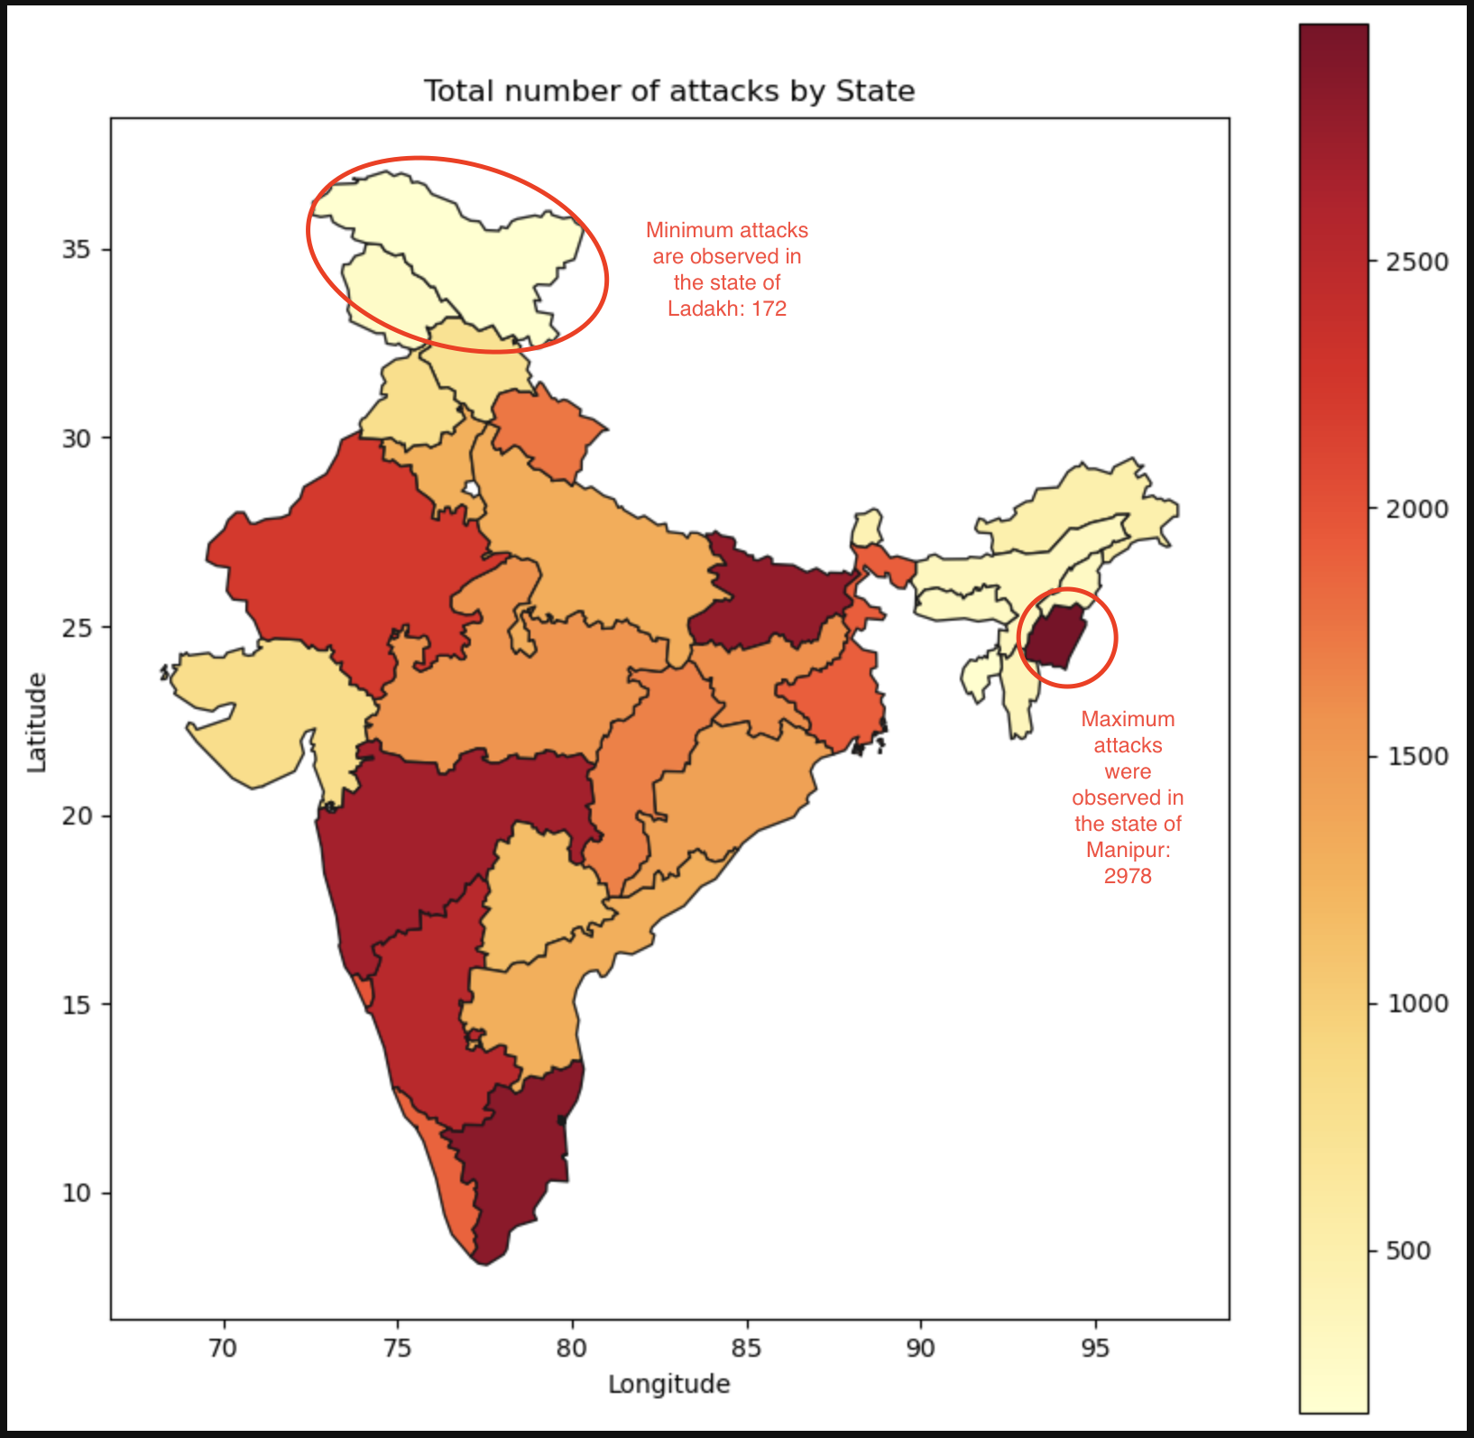
Finding 1: Interesting finding
As a SecOps manager/leader, what are hotspots in client-base and how many attacks were made and what devices were impacted?
Among the 28 states in the dataset, we find that all the states are attacked between the range 172 (Ladakh) - 2978 (Manipur)
Let’s drill-down Manipur and find out what kind of attacks are prevalent.
Top 5 states:
Manipur
Tamil Nadu
Bihar
Maharashtra
Karnataka

Slide 7
Finding 1: Interesting finding
As a SecOps manager/leader, what are hotspots in client-base and how many attacks were made and what devices were impacted?
2978
Laptop/Desktop
Mobile/Tablets
2322
656
DDoS
Malware
DDoS
Malware
Intrusion
Intrusion
790
764
768
221
221
214
NS A
NS C
NS A
NS C
NS A
NS C
NS A
NS C
NS A
NS C
NS A
NS C
NS B
NS B
NS B
NS B
NS B
NS B
270
256
258
243
275
264
76
72
68
82
67
77
264
263
229
73
71
70
NS A = Network Segment for Public sector and Defense NS B = Network Segment for Commercial Enterprise NS C = Network Segment for Commercial Individual
In the state of manipur, it is concluded that:
Public Sector customer face a majority of DDoS attacks to their laptops/desktops
This is an indicator that we have to provide more protection to customer’s laptop/desktop devices for all customer segments.

Slide 8
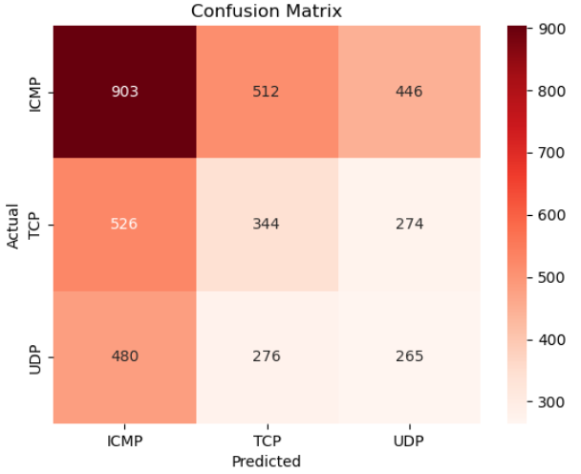
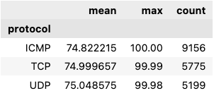
Finding 2: Non-trivial finding
As a SecOps manager/leader, can we predict the type of protocol being used in the traffic with anomalous behavior and correlate that with the most prevalent attack?
Using RandomForestClassifier, team HERO is training the dataset containing anomaly score (measure of anomalous behavior) and predicting the protocol which was used with an accuracy of 37.56%
Using this prediction and the insight in Finding 1, a correlation can be derived:
ICMP protocol was most prevalent in the anomalous traffic which were captured during the DDoS attacks
Managerial Insight: From the outcomes of findings 1 and 2, we are arrive at an understanding that a large number of DDoS attacks were made using ICMP protocol. The learning for SecOps team is to tighten up the security rules to rate traffic (especially with ICMP protocol) to the Acme’s datacenter and also monitor suspicious traffic patterns (for example: large traffic spikes during off seasons).

Slide 9
Finding 3: Somewhat unexpected finding
As a SecOps manager/leader, how can we bolster the security in our systems?
What we expected to find?
A steady decline in ignore actions, steady increase in blocked actions over a period of time
SecOps engineers improve security measures and processes to help prevent attacks For example: SecOps engineer may decide to limit the traffic flowing to an application by introducing an firewall to filter traffic to the application.
Ignored
Blocked
# of actions
Time
Unstable number of attacks which are marginally above/below the over a period of time
the Number of attacks are generally not a flatline, number of attack fluctuate based on events. For example: After a product launch, a malicious users have a new product area to break into OR After a publication of a security advisory or a security patch, a malicious user might feel challenged to or may want to verify if the security vulnerability have been eliminated or not.
Total Number of attacks
# of actions
Time
Blocked
# of actions
Logged
An increase in logged action would result in increase to the blocked action as time passes
In the SecOps team, security engineers learn from logged events and improve their preventive measures for the suspicious activities. This is attributed to ever evolving security posture of the organization.
Time

Slide 10
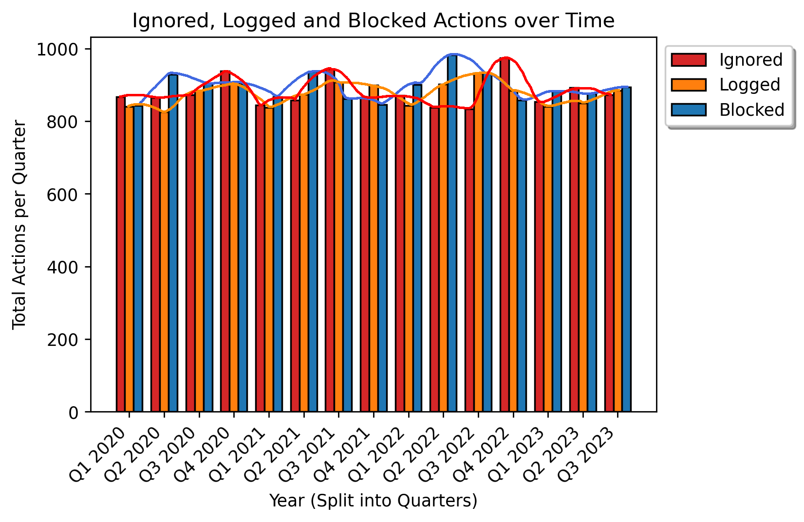
Finding 3: Somewhat unexpected finding
As a SecOps manager/leader, how can we bolster the security in our systems?
What we found instead?
The logged actions follow a consistent peaks and troughs corresponding to second half and first half of the year.
We observe from the dataset that an increase in ignored actions, lead to a decrease in the logged and blocked actions in same and next quarter.
The action taken Q1 are consistently low than the rest of the quarters.
Managerial insight:
Managerial Insight : Security processes and new security rules/profiles can be implemented by performing root-cause analysis on the Ignored and Logged actions which will eventually lead to more Blocked actions in future.

Slide 11
Backup slides
Sources:
Icons & logo: https://www.rawpixel.com/image/14588430/abstract-particle-technology-background-security-person-human
https://www.pngall.com/cleaning-logo-png/download/119899/
https://media0.giphy.com/media/v1.Y2lkPTc5MGI3NjExdXR1eGtjYXJ5azZwYzY1eXh1bjVjdDZmMGFxY3B0NGxhaWx1dWY0NCZlcD12MV9pbnRlcm5hbF9naWZfYnlfaWQmY3Q9cw/KHEqwcxQ0zKfje8rVJ/giphy.gif
Definition of cybersecurity: https://en.wikipedia.org/wiki/Computer_security
Reference for DDoS attack: https://www.cyber.gc.ca/en/guidance/defending-against-distributed-denial-service-ddos-attacks-itsm80110
ChatGPT

Slide 12

THANK YOU!!!!

